Slide 1
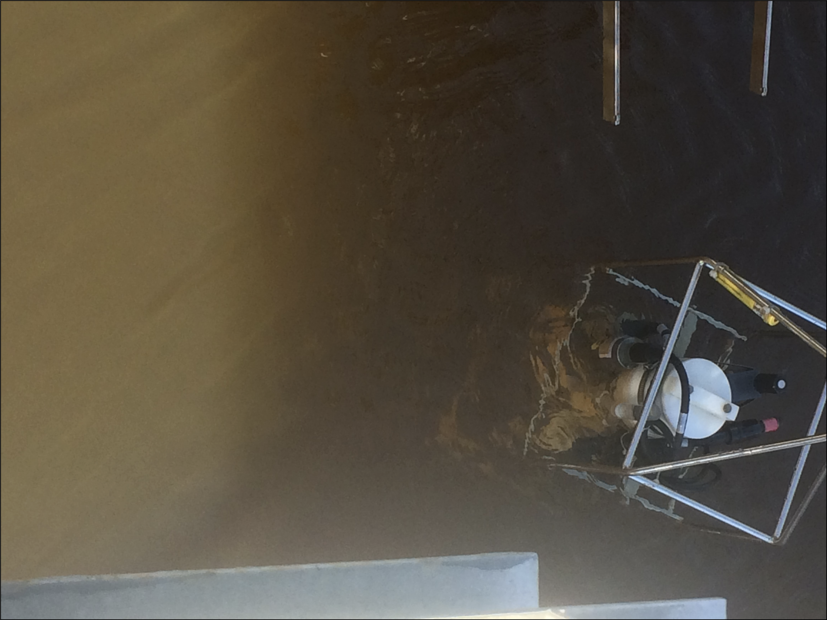
Using turbidity to assess water quality
Turbidity is a measure of water clarity.
Increases in turbidity can be due to the presence of any of the following substances in water:
Particles such as silt and clay
Microorganisms such as algae
Substances dissolved in water, such as dissolved organic matter
Highly turbid water
Falling Creek Reservoir, Vinton, VA
Photo credit: Bethany Bookout
Image: Wikimedia commons
Notes:
Turbidity is a measure of water clarity.
Increases in turbidity can be due to the presence of
Particles such as silt and clay
Microorganisms such as algae
Substances dissolved in water, such as dissolved organic matter

Slide 2

Using turbidity to assess water quality
In a treatment plant, turbidity on the bottom filter must be 0.3 Nephelometric Turbidity Units (NTU) or less!
How high the turbidity in the raw water must be before it is considered a potential water quality concern depends on a number of factors, including:
The treatment process in the plant
How much coagulant you can feed
Detention time
Operators must use their best judgment about how to manage high raw water turbidity!
Notes:
In a treatment plant, turbidity on the bottom filter must be 0.3 Nephelometric Turbidity Units (NTU) or less!
How high the turbidity in the raw water must be before it is considered a potential water quality concern depends on a number of factors, including:
The treatment process in the plant
How much coagulant you can feed
Detention time
Operators must use their best judgment about how to manage high raw water turbidity!

Slide 3
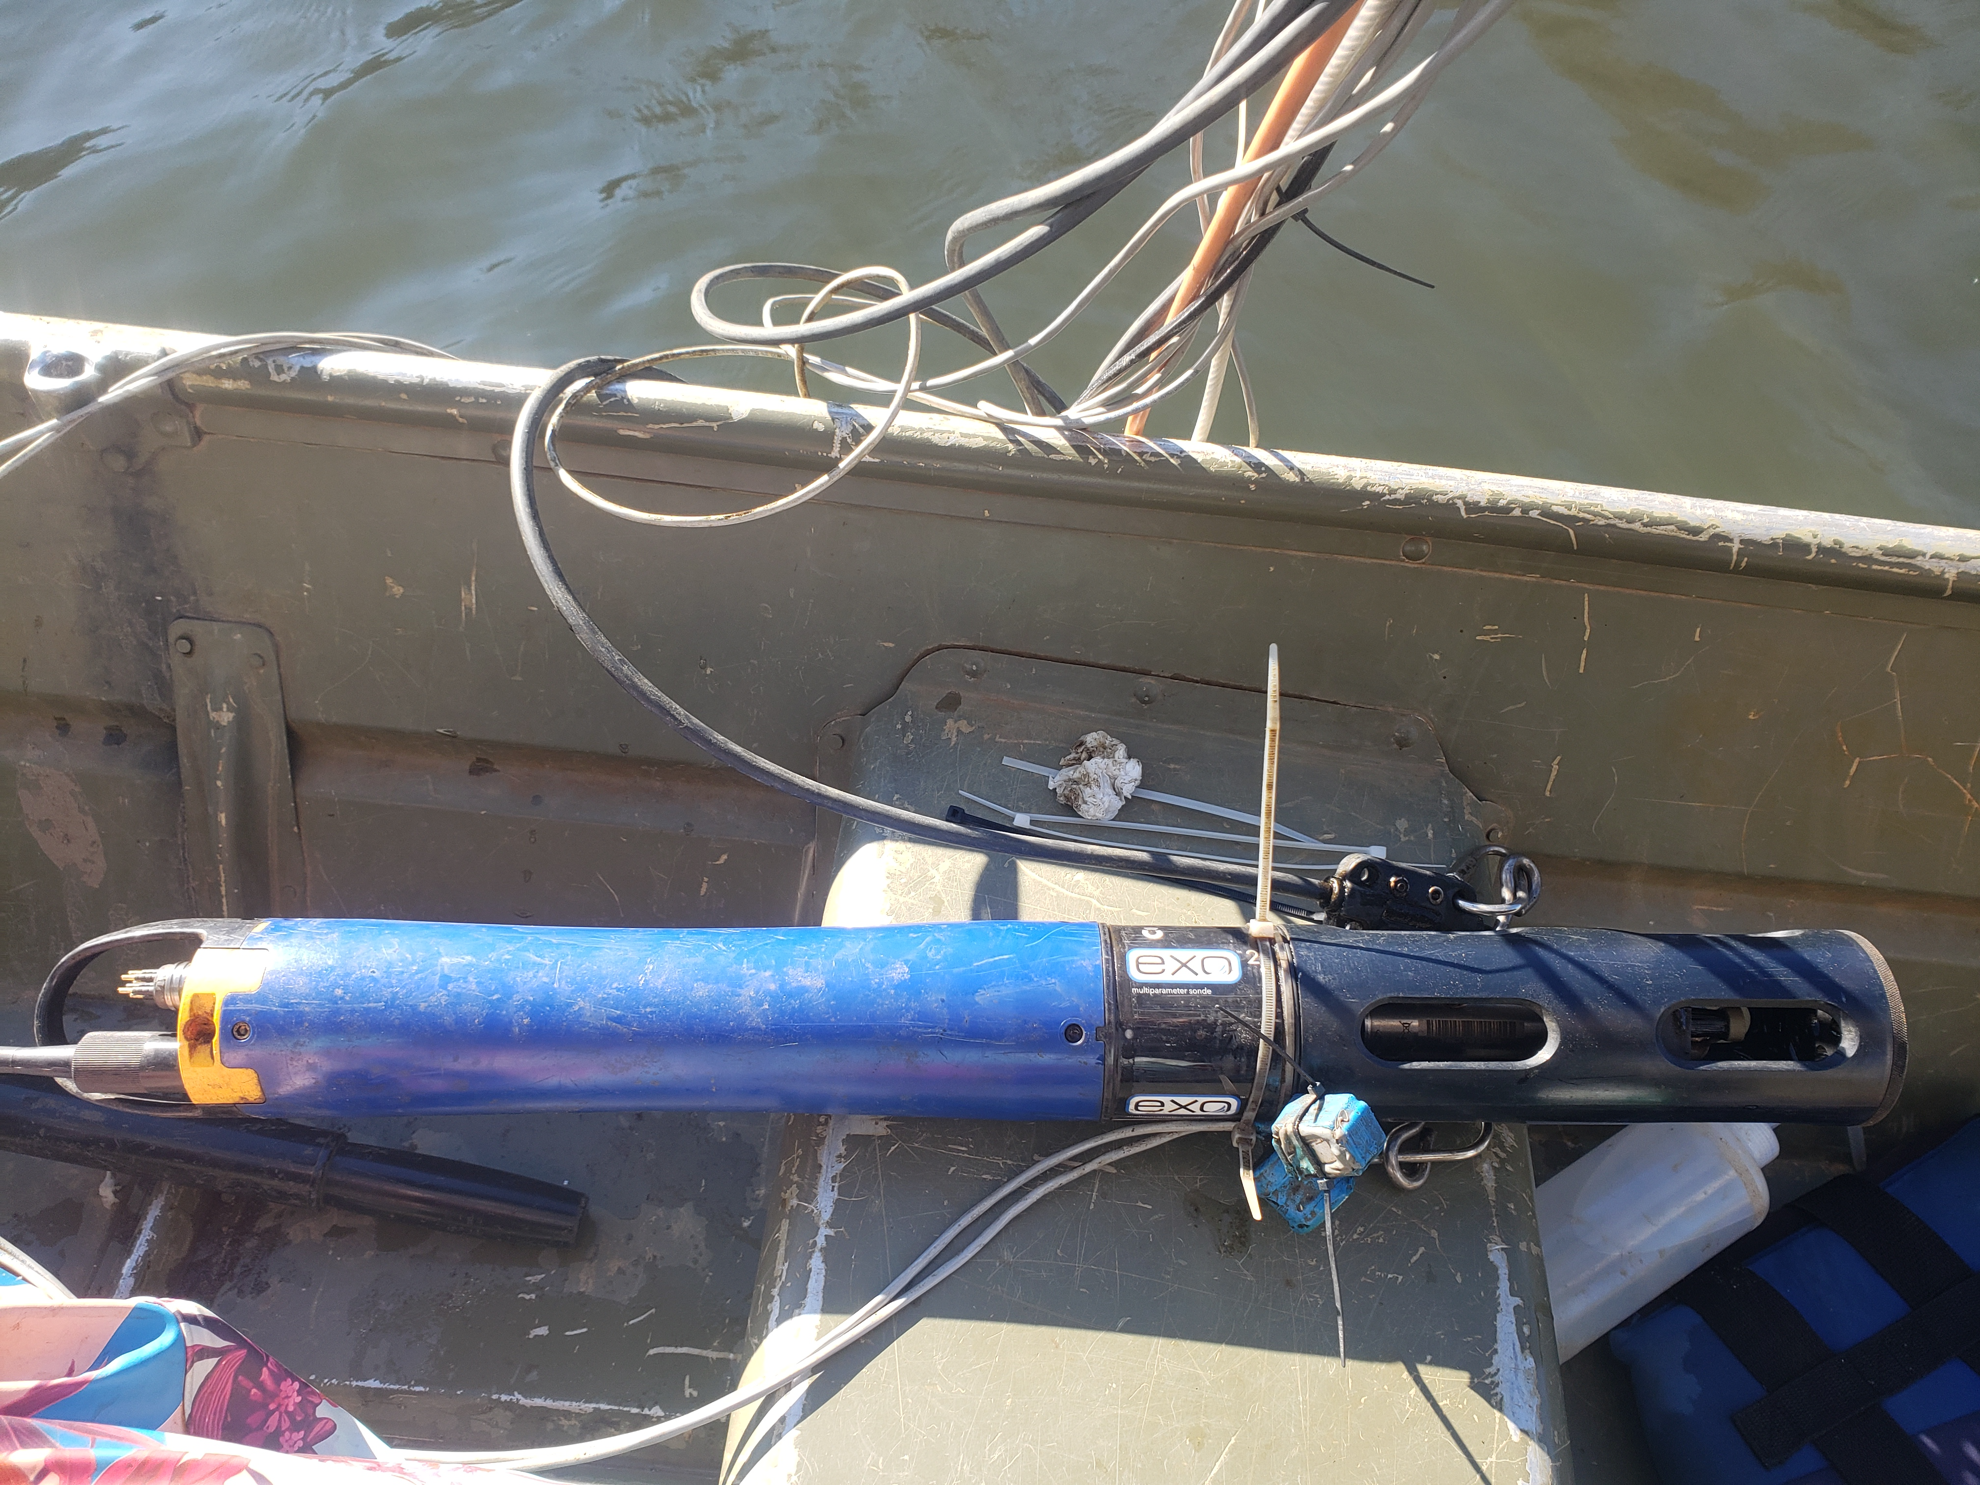
Using turbidity to assess water quality
Turbidity can be measured using high-frequency sensors
These sensors shine a light into the water and then measure how much of the light is scattered by particles and dissolved substances in the water
The more light is scattered, the higher the turbidity
In our data today, turbidity is measured in Formazin Nephelometric Units (FNU)
“Formazin nephelometric” describes what kind of light is being used to measure turbidity
Turbidity Sensor
1 FNU = 1 NTU
Photo credit: Adrienne Breef-Pilz
Notes:
Turbidity can be measured using high-frequency sensors
These sensors shine a light into the water and then measure how much of the light is scattered by particles and dissolved substances in the water
The more light is scattered, the higher the turbidity
In our data today, turbidity is measured in Formazin Nephelometric Units (FNU). “Formazin nephelometric” describes what kind of light is being used to measure turbidity. You may also hear turbidity values reported as Nephelometric turbidity units, or NTU. While the type of light that is used to measure turbidity is different for FNU and NTU, you can generally consider 1 FNU to be about equivalent to 1 NTU.

Slide 4
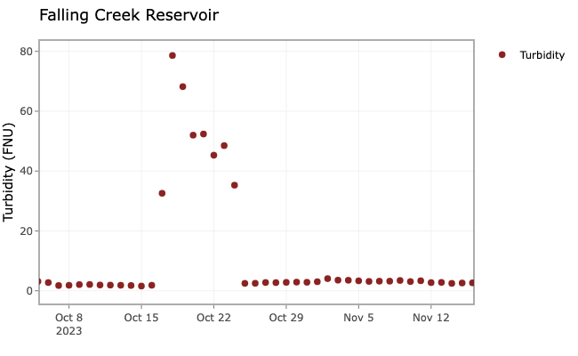
Using turbidity to assess water quality
Excess turbidity can clog treatment plant filters, requiring more frequent cleaning or changing of filters.
High turbidity events can negatively affect water quality
Notes:
Excess turbidity can clog treatment plant filters, requiring more frequent cleaning or changing of filters.
High turbidity can occur during or shortly after rainstorms which move sediment into the reservoir through runoff. High turbidity can also occur around the time of fall turnover depending on the water quality characteristics of the reservoir during summer thermal stratification.

